Slide 1
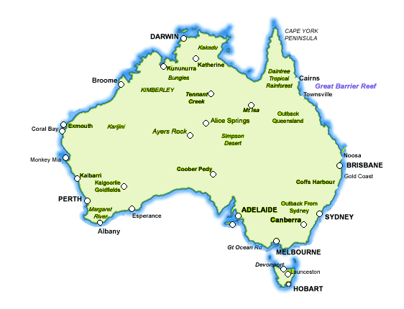
Australian Tropical Science and Innovation Precinct
The Centre for Marine Microbiology and Genetics Research
Queensland Biosciences Precinct- 16 research Instututes & centers
Harry Perkins Institute of Medical Research (WAIMR)
Victoria bioscience Precinct (Melbourne)
Central Parkville Precinct
Bio21 cluster
Monash Health Research Precinct
Alfred Medical Research and Education Precinct

